Slide 1


Data Science Mini Project
Timothy Lim ()
Raymond Lim Wei ()
Le Duy Linh ()
Course: SC1015
SC18 Group 9
Notes:
Good Evening Prof, my name is Raymond and today I will be presenting my group’s Data Science Mini project

Slide 2
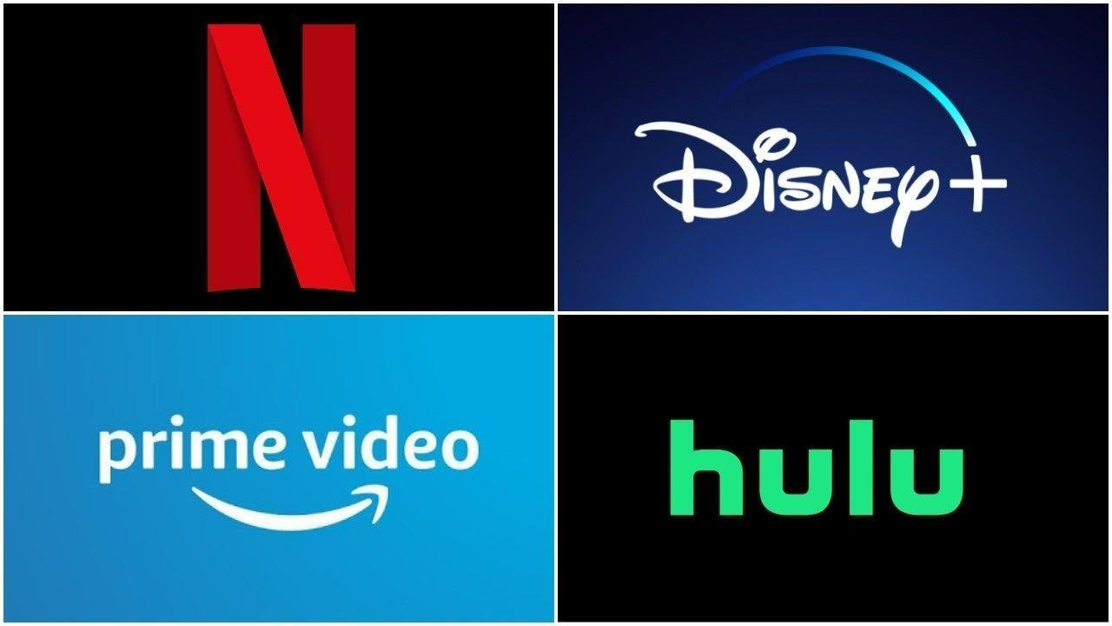
Problem Definition & Motivations
Create a model that can accurately predict IMDb Scores of movies
Recent increase in movie production due to newer and bigger streaming platforms
Are we able to predict the IMDb Score of Movies based on their metrics? Metrics such as Genre, Age Category or Runtime
Which metrics are the best for predictions?
How will different models will affect our predictions?
Notes:
The goal for our project is to create a model that can accurately predict IMDb Scores of movies
Our motivation is due to the recent increases in movie production that made us wonder how we can go about predicant scores of future releases
We want to know if we can predict scores using metrics like genre, age category or runtime
We also want to know which metrics are best for predictions and how different models can affect our predictions

Slide 3

Our Datasets
Data Sets:
Movies on Streaming Platforms 1914 - 2021: https://www.kaggle.com/code/ruchi798/movies-and-tv-shows-eda/data?select=MoviesOnStreamingPlatforms_updated.csv
Movies on Streaming Platforms 1902 - 2020 https://www.kaggle.com/code/armintalic/quality-and-quantity-of-streaming-services-content/data?select=MoviesOnStreamingPlatforms_updated.csv
Notes:
For our data we chose 2 datasets that contained movies available on the various streaming platforms the datasets included movies from 1914 to 2021 and 1902 to 2020
These datasets also include imdb scores and various other metrics

Slide 4
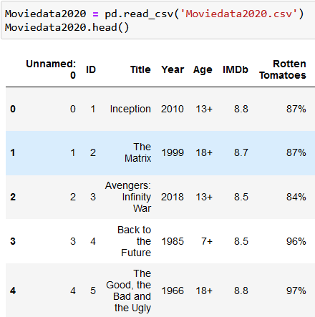
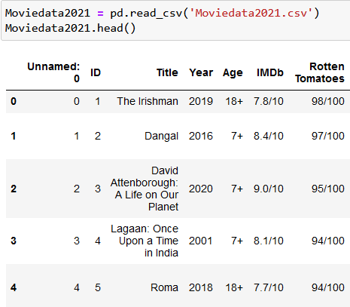
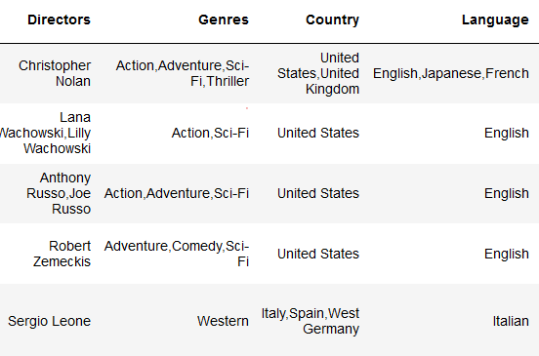
Data Processing & Cleaning
Merged both csv files together
Used various Excel & Python functions process the data
Processed data for IMDb & Rotten Tomatoes from x/10 and percentage values to floats
Removed duplicate movies
Reduced variables such as Genre, Language & Country of Origin to their Main Genre/Language/Country
Notes:
We processed the datasets by merging both into one csv file
Then we used various excel and python functions to process our data
This included changing data for the IMDb Score from an out of 10 value and percentage values to float values
We also narrowed down Columns with multiple values to the main value

Slide 5
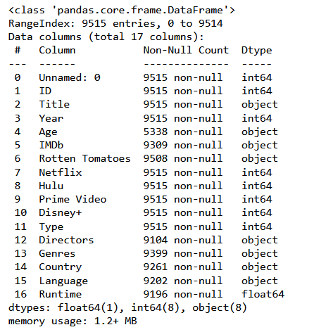
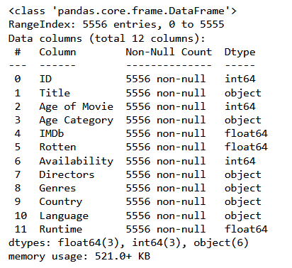
Data Processing & Cleaning
Altered our data fields to more appropriate columns for analysis
E.g Changing Year of Release to Age of Movie
Consolidating Availability on Individual platforms to a unified Availability Metric
Drop NaN values from our dataset
Notes:
We changed certain data to make it more appropriate such as the Year of Release to an Age value
Consolidated Availability metrics on different platforms into a numeric value and dropped rows with empty values

Slide 6

Exploratory Data Analysis
Separated into 2 Types of Variables
Numerical: Age of Movie, IMDb (IMDb Score), Rotten (Rotten Tomatoes Score) & Runtime
Categorical: Age Category, Availability (Platform Availability), Genres, Country &Language
Notes:
For our exploratory data analysis we separated our variables into numerical and categorical
Numerical includes age of movie, Imdb Score, Rotten tomatoes score and runtime
Categorical included age category, genre and more

Slide 7
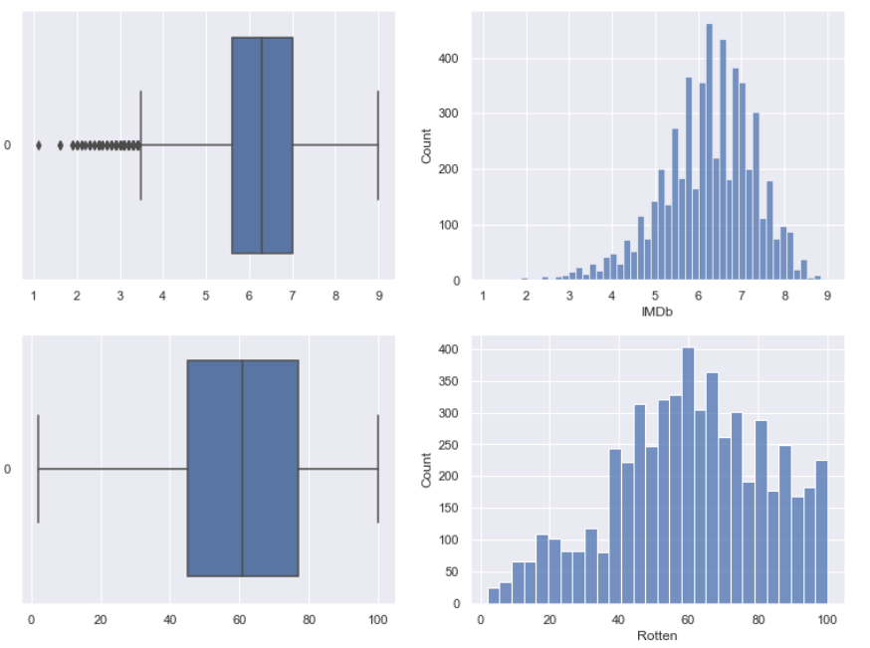
Numerical Exploratory Data Analysis
Variables like IMDb & Rotten did not have many outliers/anomalies
Notes:
In our Numerical analysis variables like IMDb & Rotten did not have many outliers or anomlaies

Slide 8
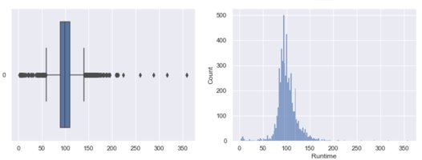
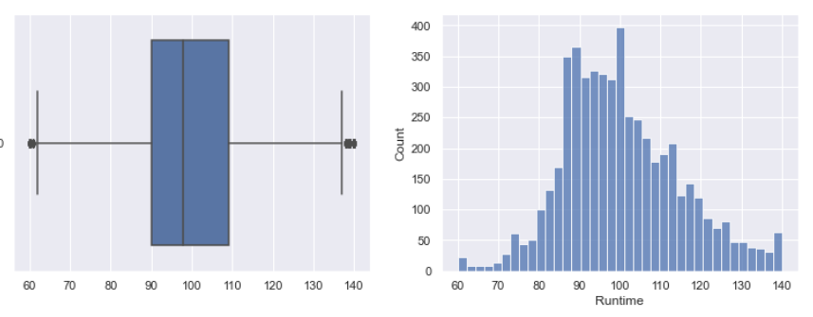
Numerical Exploratory Data Analysis
Runtime variable had a lot of outliers, and we removed the values that fell out of +/- 1.5* Interquartile Range (IQR)
This resulted in a much better distribution of Runtime values
Notes:
However, runtime variables had a lot of outliers, hence we removed the values that fell out of 1.5 times the interquartile range
This resulted in a better distribution of values

Slide 9
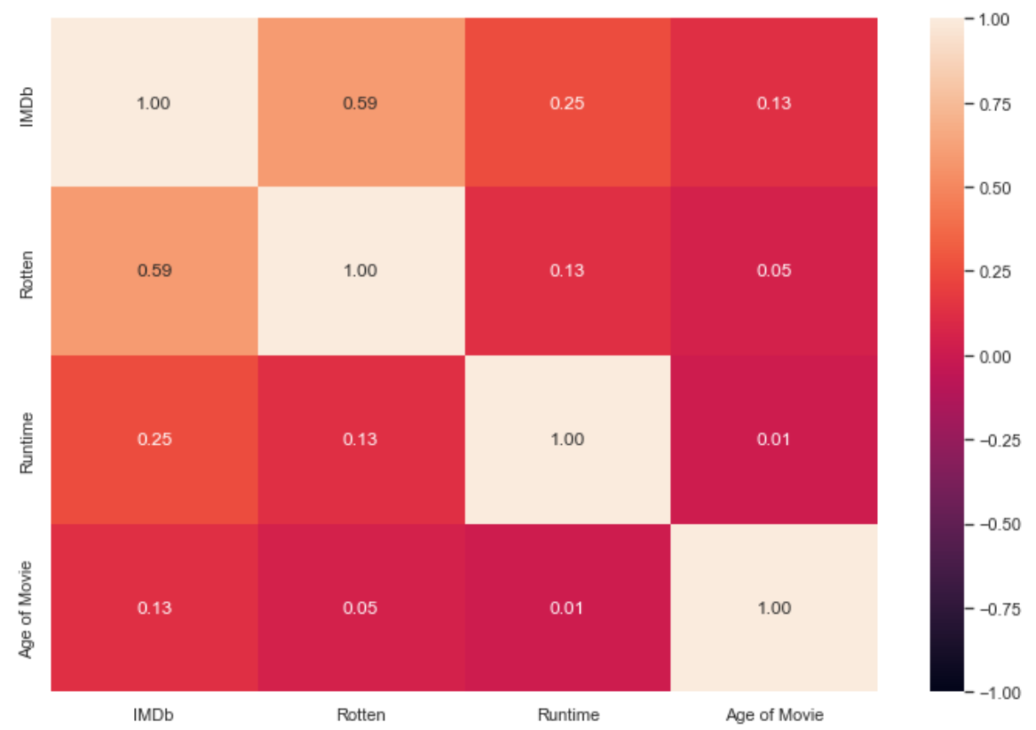
Numerical Exploratory Data Analysis
Correlation Matrix to view the relationship between IMDb & other numeric variables
Correlation Matrix
Rotten Tomatoes had highest correlation of 0.59
Runtime & Age of Movie were significantly worse in their correlation scoring 0.25 & 0.13 respectively
Notes:
We also explored a correlation matrix to see the relationship between IMDb and other numeric variables,
Rotten Tomatoes score had the highest correlation of 0.59
Run time and age of movie were much worse in their correlation

Slide 10
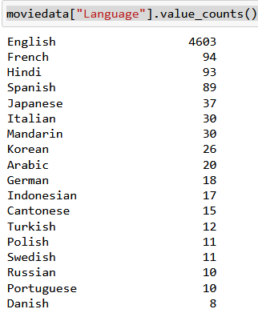
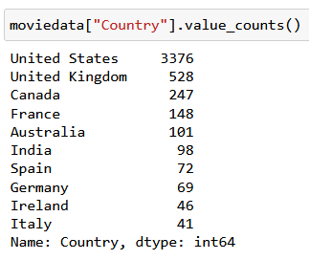
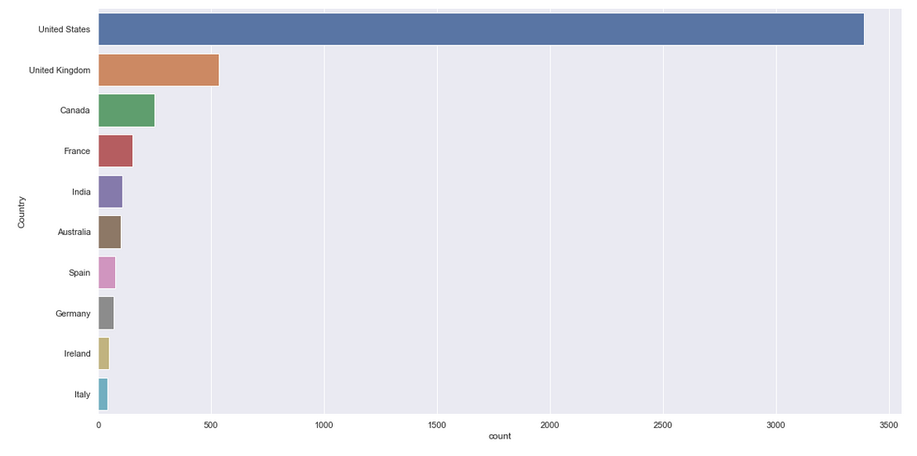
Categorical Exploratory Data Analysis
Variables such as Country & Language had a lot of categories
Majority of the movies were concentrated in the top few Countries/Languages
We kept the 10 Countries/Languages with the highest movie count to reduce the number of outliers
Notes:
In our categorical analysis we realized that some variables like country and language had a lot of categories, 78 for languages and 58 for countries
However most of the movies were concentrated in the top few countries/languages
We decided to keep the 10 languages and countries with the highest movie count to make the categorical variables more manageable for our later model and reduce number of outliers

Slide 11
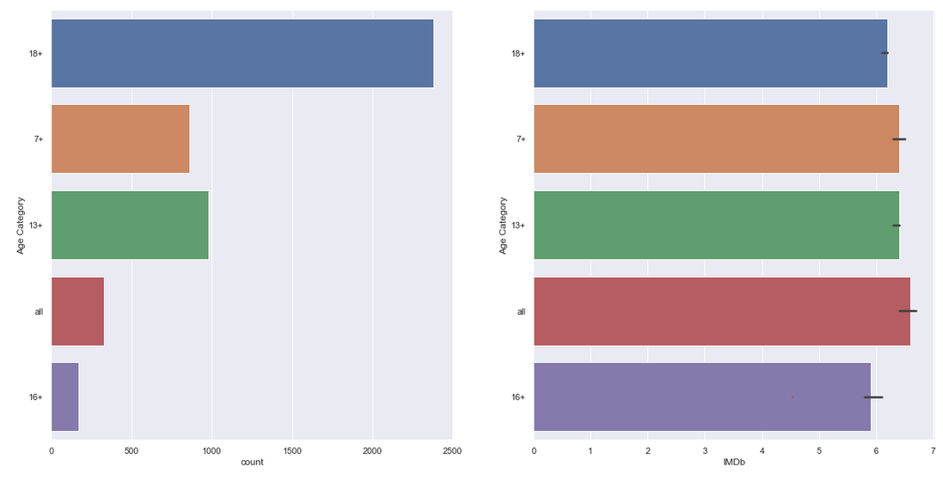
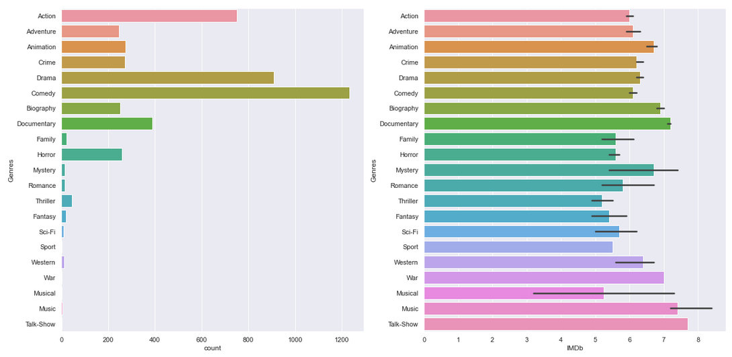
Categorical Exploratory Data Analysis
Variables such Age Category & Genre had far less categories per variable
We plotted Age Category & Genre against the Median IMDb Score for each category and noticed that the median scores for each Age Category/Genre were fairly similar
Notes:
Other categorical variables Age category and genre had less categories, genre had similar count distribution to countries where most of the movies were focused in a few genres like comedy, drama or action
Age category was more spread out but had movies focused in the 18+ and 13+ categories
however it is interesting to see that when we plot the variabeles against the median imdb score for a category there were not much differences in median score for age category whereas median scores for different genres varied quite abit

Slide 12

Prediction Models
Linear Regression
Numerical Univariate Regression
Multivariate Regression with Categorical Variables
Random Forest
Random Forest Classification
Random Forest Regression
Notes:
For our Score and metric prediction we use a few models

Slide 13

Metrics & Predictability
Which Metrics have the highest ability to predict IMDb Scores?
We made use of 2 models to find out
Uni-Variate Linear Regression
Random Forest Classicfication
Notes:
For metric prediction we wanted to find out which metric had the best ability to predict scores
We used 2 models for this

Slide 14
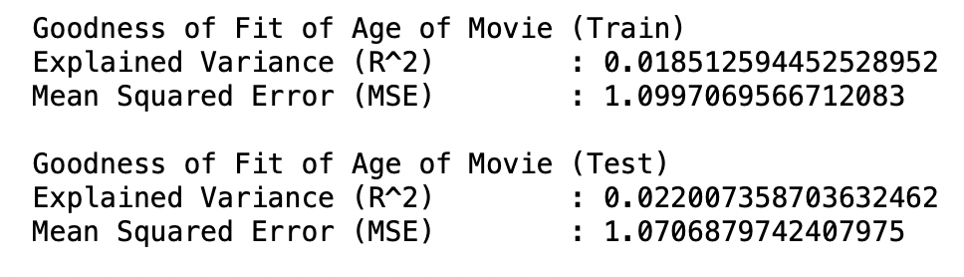
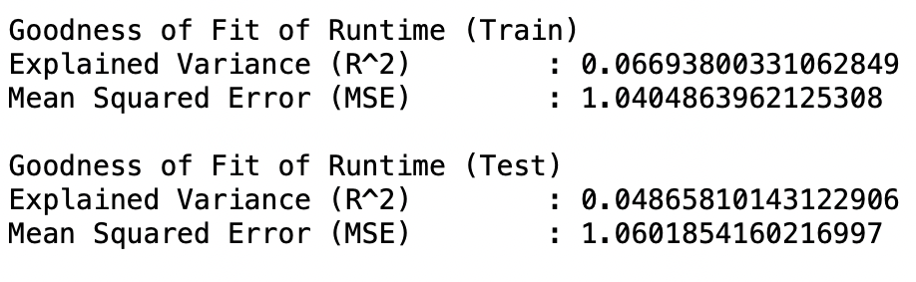
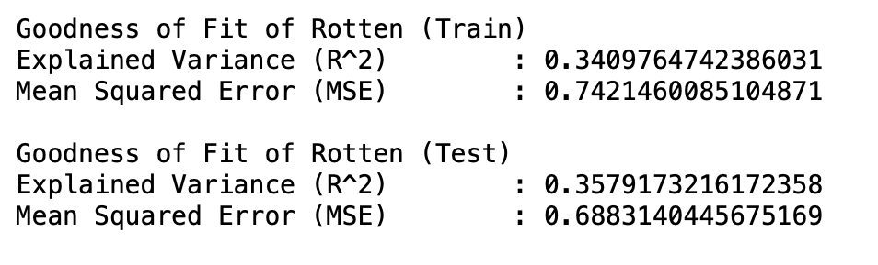
Uni-Variate Numerical Linear Regression
We performed Uni-Variate Linear Regression on the numeric variables in our dataset to find which values had the greatest impact on IMDb Score
Numeric Variables: Age of Movie, Runtime, Rotten Tomatoes Scores
Rotten (Rotten Tomatoes Score) had the highest Explained Variance (R^2) value & lowest Mean Squared Error (MSE) value
These values indicated that it the best predictor of IMDb Scores
Notes:
We did uni-variate regression on our numeric variables to find which had the best ability to predict scores.
We derived the Mean Squared Error and Explained Variance of each numeric regression model
Rotten Tomatoes score had the highest explained variance and lowest Mean Squared Error value of the 3 numeric variables
This made it the best predictor of IMDb Scores

Slide 15
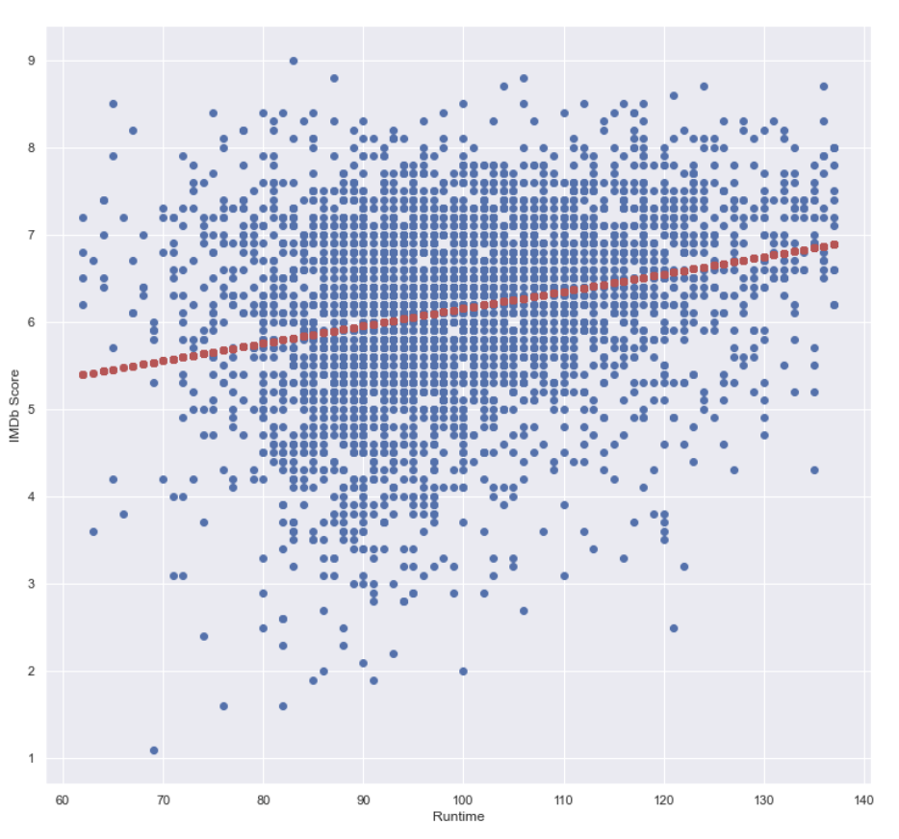
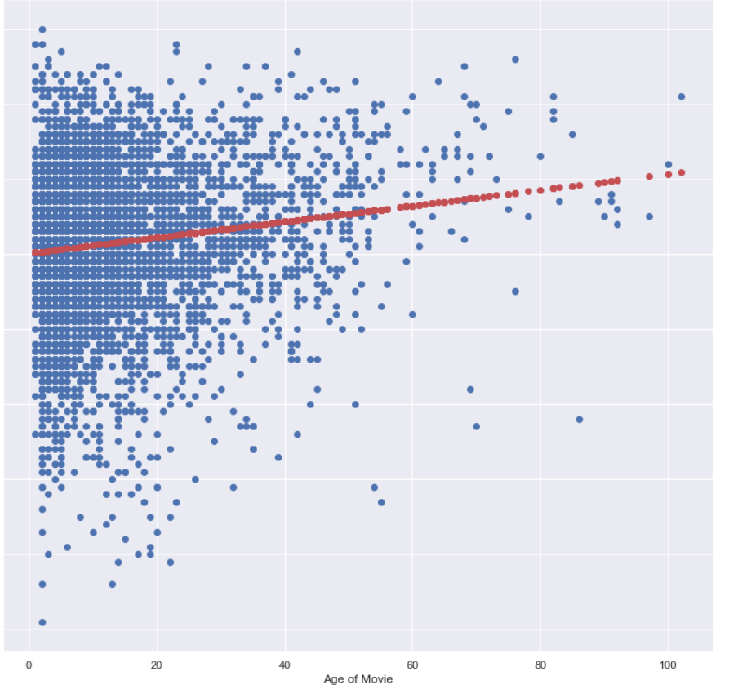
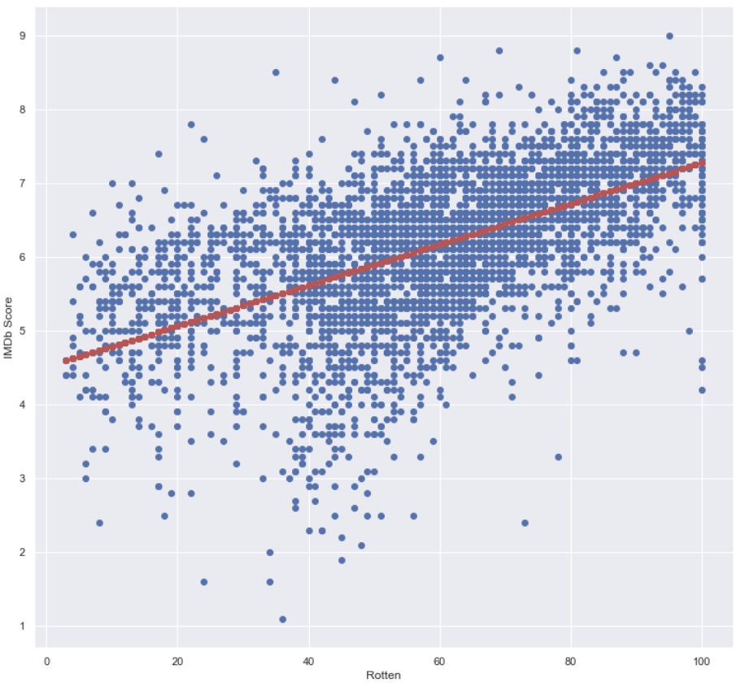
IMDb Score
Runtime
Age of Movie
Rotten
Notes:
Viewing the graph of each linear regression model you can see that the values on the rotten tomatoes graph are much more clustered along the main regression line compared to the runtime and age of movie graphs where points are scattered further from the regression line

Slide 16
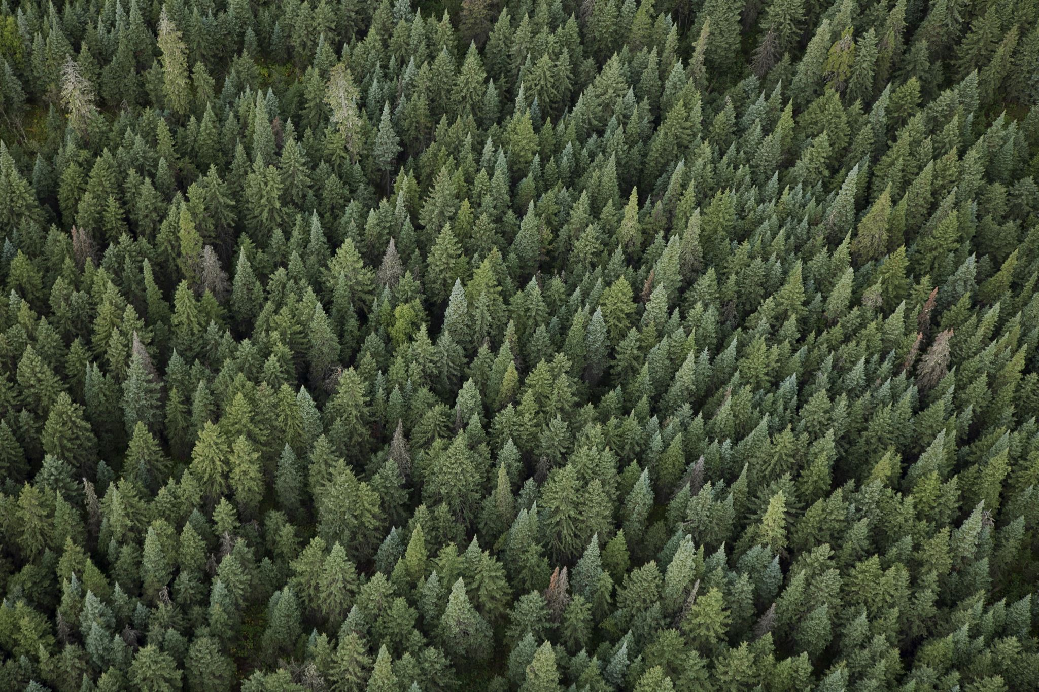
Random Forest
Random decision forests is an ensemble learning method for classification, regression and other tasks that operates by constructing a multitude of decision trees at training time
Random forest builds multiple decision trees and merges them together to get a more accurate and stable prediction
For classification tasks, the output of the random forest is the class selected by most trees
For regression tasks, the mean or average prediction of the individual trees is returned
Wikipedia
Notes:
We also explored using Random Forest
Random forest uses ensemble learning method for classification and regression and it creates many different decision trees
Merging the results of the trees together gives this model a more accurate and stable prediction

Slide 17
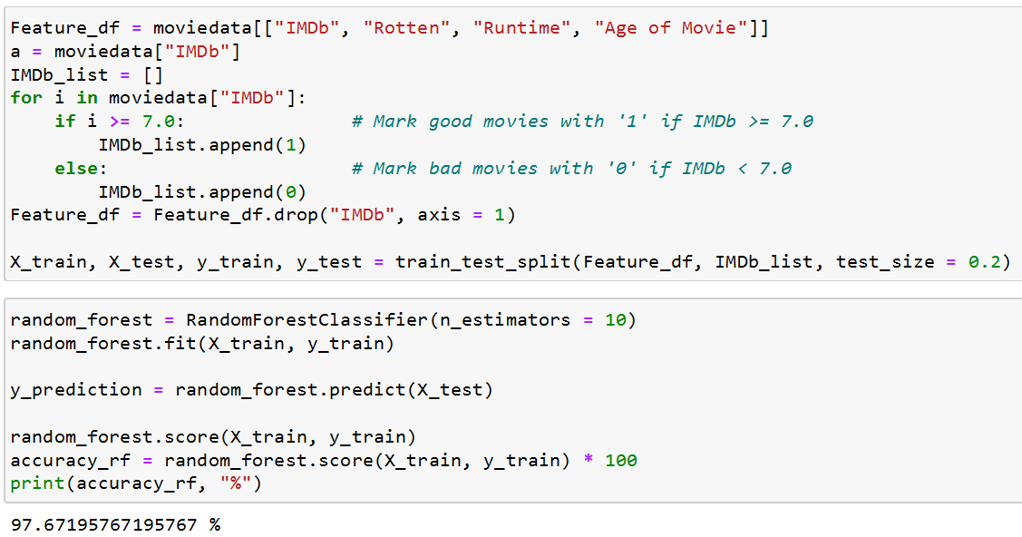
Random Forest Classification
IMDb Score was classified into two categories:
Good Movies: IMDb Score greater than or equal to 7.0
Bad Movies: IMDb Score smaller than 7.0
Movies were classified using Numeric Variables Rotten, Runtime & Age of Movie
Random Forest Classification had an accuracy of 97.67% in predicting which Category a movie was likely to fall in based on the variables
Notes:
Using our Random Forest classification, we classisifed imdb scores greater or equal to 7 to be good movies and scores below 7 to be bad movies
These movies were then classified into these categories using our numeric variables
The random forest classification had an accuracy of 97.67% in predicting which category a movie was to fall in based on variables

Slide 18
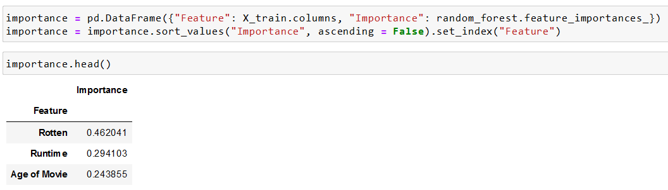
Random Forest Classification
A feature of Random Forest Classification is the measure of relative importance of each variable to the final classification
We conclude again that Rotten Tomatoes Score ('Rotten') is the most important feature while 'Age of Movie' is the most insignificant one.
Notes:
In doing it’s classicfication, the random forest classification mode also measured the importance of each numeric variable in influencing the classification based on an importance score
The classification was quite accurate at 97% and the variable that hahd the highest importance score and was most important to this accuracy was once again Rotten Tomatoes
This supports our earlier prediction that the Rotten Tomatoes score was the most accurate metric to use in predicting IMDb scores

Slide 19
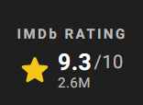
IMDb Score Prediction
What Models can we use to Predict Scores?
Which Model is better?
How accurate are predictions?
Notes:
Now we move on to actual score prediction
We want to know which models we could use to predict,
Which model is better and how accurate it is

Slide 20
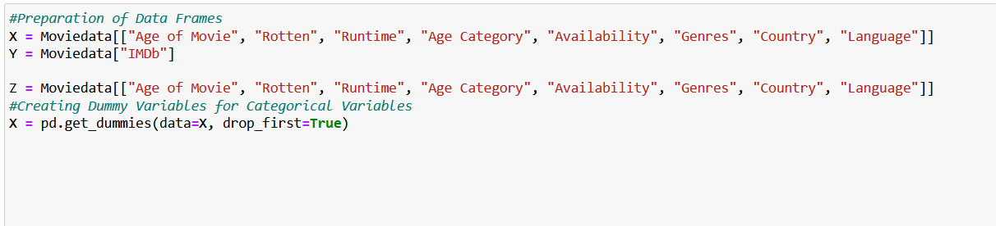
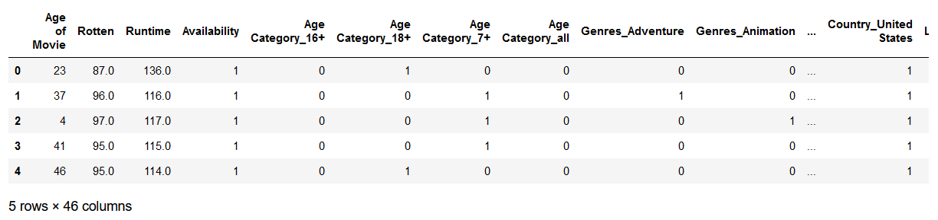
Categorical Linear Regression
To get more accurate results we want to make use of Categorical Values in our regression model
Dummy coding allows us to turn categories into dummy variables a regression model can treat as having a high (1) and low (0) score. Now the regression can look at directionality affected by a Category by comparing binary values
We create a dataset with dummy variables created for all the Categorical Values
We combine our Numeric Variables with Dummy Variables to create a Multi-variate Linear Regression Model
Notes:
To get better results, we opted to learn how to use categorical variables in liner regression
This involved using Dummy coding which allows us to turn categories into dummy variables a regression model can treat as having a high (1) and low (0) score. Now the regression can look at directionality affected by a Category by comparing binary values
We then combined these dummy variables with our numeric variables to form a multi variate regression model

Slide 21
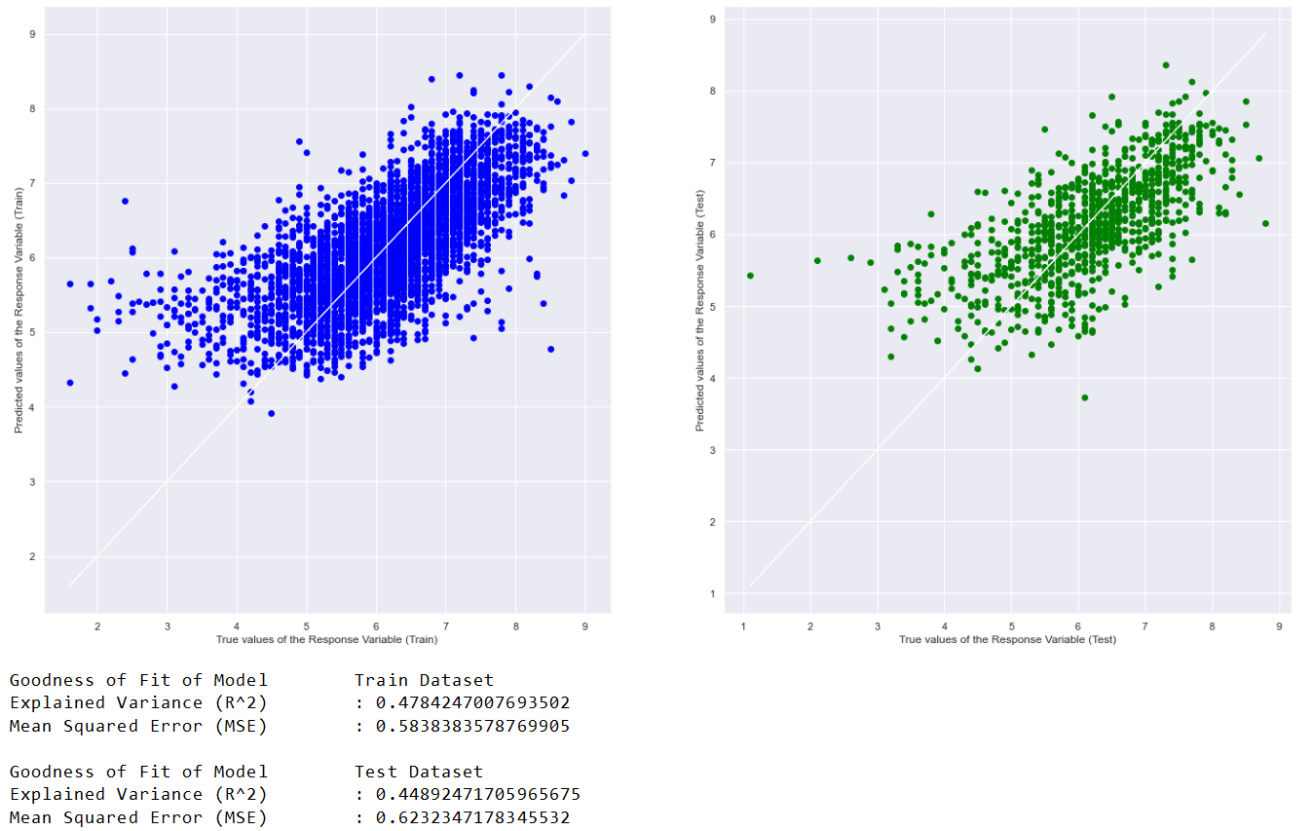
Multi-Variate Linear Regression
We merged our numeric & dummy variables to create our Multivariate Regression Model
The MSE for our Multivariate Regression Model was 0.6232
This is lower and hence more accurate than the Uni-Variate Regression Model using 'Rotten' which produced an MSE of 0.6883
Notes:
The Mean Square Error for this model was lower than the Uni-Variate model using only Rotten Tomatoes score, hence this model improves our accuracy of prediction

Slide 22
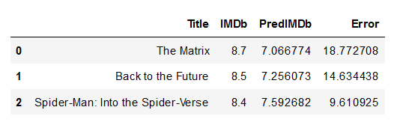
Multivariate Linear Regression Predictions
Using our Multivariate Regression Model we were able to predict scores of 3 different movies
The average error of the predictions is 14% for these 3 movies
The Predictions are a decent guess but not as accurate as we would like
Notes:
We also ran actual predictions using the model on a few movies and found a an average error of 14%
Our predictions are an average guess but not as accurate as we would like

Slide 23

Can we use Random Forest to predict?
We wanted to know if Random Forest might produce a better Regression Model
Random Forest Model takes significant time to compute prediction results (> 15 minutes) vs Multi-Variate Linear Regression (>1 minute)
Is it worth using time & resources to run this model to predict a score?
Notes:
We wanted to know if random forest could produce a better model
However random forest uses a lot more time and computer resources to compute a result hence we wanted to know if it would be worth it

Slide 24
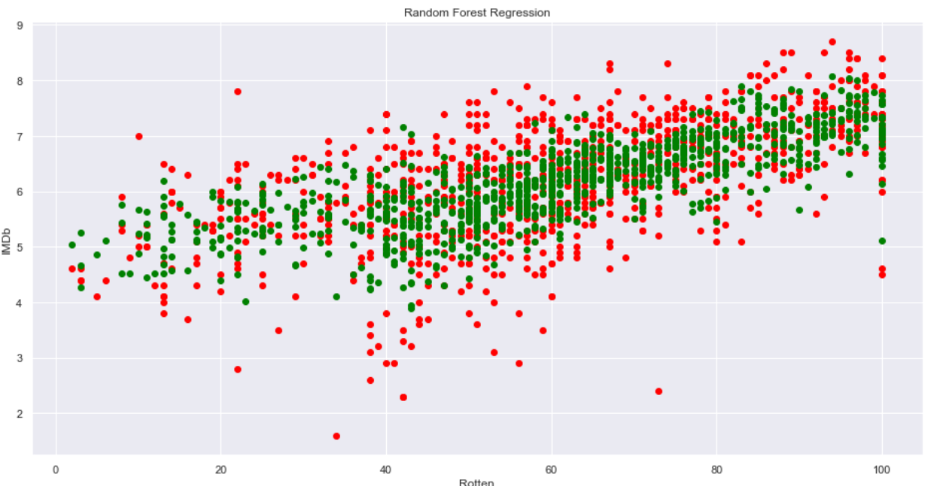
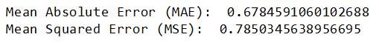
Random Forest Regression
We plotted the predictions of our Random Forest Model against the true values
The red values are the true values, green are the predicted values
Higher Mean Squared Error (MSE) of 0.7850, (>0.6232) compared to that of our Multi-Variate Regression model
It is not worth running the Random Forest Regression Model
Notes:
After running the Random Forest Model we plotted the predictions against our imdb true values
The mean squared error of the random forest model was higher than the multivariate regression model
It had a mean squared error of 0.7850 compared to 0.6232 of our multi variate regression model
It is less accurate and consumes more resources and time hence it is not worth running the random forest regression model

Slide 25
Outcomes of Our Project & Learning Points
We successfully created a model that can predict IMDb Scores of Movies using various metrics of both numeric and categorical type
We were able to determine that out of these, Rotten Tomatoes Score was the best metric in predicting the IMDb Score of Movie using Random Forest Classification, Correlation and Uni-Variate Linear Regression
We learned to engage in different models such as Random Forest & methods of using Categorical Variables in Linear Regression
Notes:
Our outcomes are that we have successfully created a model to predict Imdb scores using different metrics
We were able to determine that out of our metrics rotten tomatoes socre was the best metric in predicting imdb score, using our uni variate regression and random forest classification
We also learned to engage in different models such as Random Forest & using Categorical Variables in Regression

Slide 26
Data Driven Insights
Rotten Tomatoes Score was the best metric in predicting the IMDb Score of Movie as the details that go into a complex score like IMDb score that describe multiple parts of a movie viewing experience is likely captured within Rotten Tomatoes Scores as well
Variables like Runtime & Age of Movie have little significance on IMDb Score, does not affect how well it fairs in ratings
High prediction errors is likely due to low correlation of variables used in predicting such as Runtime & Age of Movie. It would be better to search for variables with higher correlation for better predictions
In predicting IMDb Score, Random Forest is less accurate & more resource intensive than Multi-Variate Linear Regression and not worth doing
Notes:
Some insights we had was that Rotten tomatoes score are likely the best predictor as movie scores are very quite complex to predict but the factors in a rotten tomato scoring likely overlaps with imdb scoring
Runtime and age of movie do not affect imdb scores
High prediction errors are likely due to the low correlation from variables like runtime and age of movie, to get more accurate predictions we should search for variables with higher correlation
In predicting IMDb score random forest is less accurate and more resouruce intensive than multi variate regression

Slide 27

Thank You

